Slide 1
Testing. General rules

Slide 2
To do or not to do?
To test:
• tests verify the correctness of the code
• and allow you to fearlessly change the code even in large ones
projects.
• Do not test:
• Writing tests takes time
• Often in the test project more than the code,
• running tests do not guarantee correctness.
• The answer is obvious: of course, to test!
Notes:
Unittest are meaning

Slide 3
8 Principles of Better Unit Testing
Know what you're testing
Unit tests should be self-sufficient
Tests should be deterministic
Naming conventions
Do repeat yourself
Test results, not implementation
Avoid overspecification
Use an Isolation framework
Notes:
* Check for a details https://esj.com/Articles/2012/09/24/Better-Unit-Testing.aspx?Page=1

Slide 4
Example
import itertools def rle(iterable): """ Applies run-length encoding to an iterable. """ for item, g in itertools.groupby(iterable): yield item, sum(1 for _ in g) print(list(rle(“missisippi"))) → [(‘m', 1), (‘i', 1), (‘s', 2), (‘i', 1), (‘s', 2),...]

Slide 5
Testing with print?
Print function helps to get half automated testing out of interactive mode.
Python interpreter print something – you check results visually
def test_rle(): print(list(rle("hello world!"))) test_rle() →
[('h', 1), ('e', 1), ('l', 2), ('o', 1), (' ', 1), ('w', 1), ('o', 1), ('r', 1), ('l', 1), ('d', 1), ('!', 1)]
Notes:
Unittest are meaning

Slide 6
Testing. Doctest
Notes:
* https://docs.python.org/3.6/library/doctest.html

Slide 7
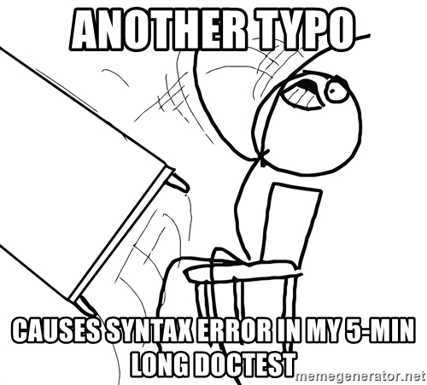
To do or not to do?
The doctest module searches for pieces of text that look like interactive Python sessions, and then executes those sessions to verify that they work exactly as shown.
Notes:
* https://docs.python.org/3.6/library/doctest.html

Slide 8
Doctest
There are several common ways to use doctest:
To check that a module’s docstrings are up-to-date by verifying that all interactive examples still work as documented.
To perform regression testing by verifying that interactive examples from a test file or a test object work as expected.
To write tutorial documentation for a package, liberally illustrated with input-output examples. Depending on whether the examples or the expository text are emphasized, this has the flavor of “literate testing” or “executable documentation”.
Notes:
* https://docs.python.org/3.6/library/doctest.html

Slide 9
Doctest
import doctest import itertools def rle(iterable): """Applies run-length encoding to an iterable. >>> list(rle("")) [] >>> list(rle("mississippi")) [('m', 1), ('i', 1), ('s', 2), ('i', 1), ('s', 2), ('i', 1), ('p', 2), ('i', 1)] """ for item, g in itertools.groupby(iterable): yield item, sum(1 for _ in g) if __name__ == "__main__": doctest.testmod()
Notes:
* https://docs.python.org/3.6/library/doctest.html

Slide 10
Doctest
$ python ./test_doctest.py # можно python -m doctest ***************************************************** File "test_doctest.py", line 10, in __main__.rle Failed example: list(rle("mississippi")) Expected: [('m', 1), ('i', 1), ('s', 2), ('i', 1), ('s', 2), ('i', 1), ('p', 2), ('i', 1)] Got: [('m', 1), ('i', 1), ('s', 2), ('i', 1), ...] ****************************************************** 1 items had failures: 1 of 2 in __main__.rle ***Test Failed*** 1 failures.
Notes:
* https://docs.python.org/3.6/library/doctest.html

